Slide 1
Basics of ML and DL using Python
-Adithya Thonse

Slide 2



About Me
Electronics Engineer with background in Deep Learning for Embedded Applications
Expertise in TinyML
Vision Applications
Predictive Maintenance
Real Time Anomaly Detection
4 years experience at Texas Instruments
Trekking Enthusiast, Gym Freak, Cyclist

Slide 3
Generic Info about this course
Entirely taught using jupyter notebooks. Using Google Colab
Pre-requisite: Basic understanding of programming.
Course material available at GitHub
Includes course teachings - Course Teaching- Python and ML
And self practice notebooks - Python_Basics_Practice
Concepts will be taught via a single consolidated presentation
You can mail me anytime at: adithya.t@intellipredikt.com

Slide 4
ML Ideology -1

Slide 5
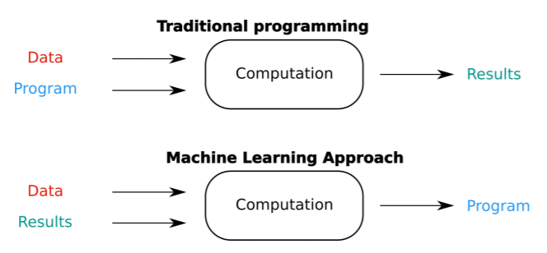
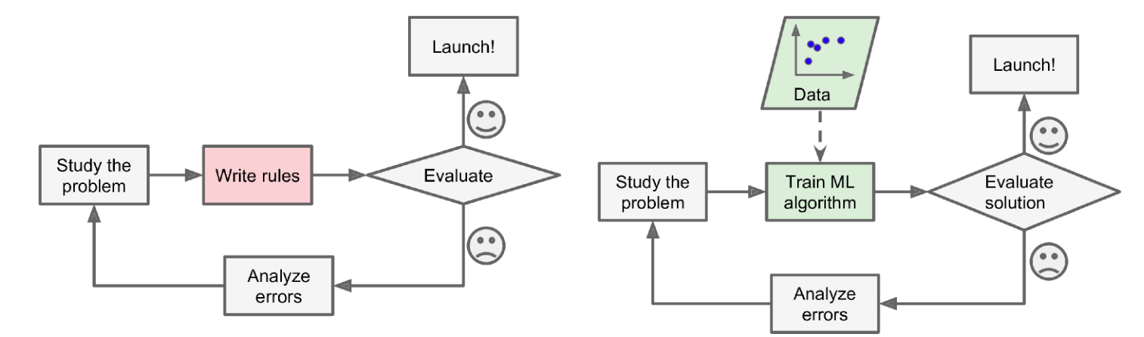
Machine Learning Process
Traditional Approach
ML Approach

Slide 6

Machine Learning Workflow
Frame the ML problem by looking at the business need
Identify subproblems
Establish baselines
Define what is success?
Gather the data and do Data Munging/Wrangling
Explore the data – Pandas, Numpy, Matplotlib
Clean data and prepare for the downstream ML models - Preprocessing
Explore different models, perform V&V and shortlist promising candidates – SciKit Learn/TensorFlow/PyTorch
Fine-tune shortlisted models and combine them together to form the final solution – Bagging/Boosting/Voting Classifiers
Present your solution
Say a story with the data – PowerPoint/Tableau/ PowerBI
Deploy – Embedded Hardware (MPU?MCU), Cloud Platform
Monitor performance
Gather updated data
Repeat 1-5

Slide 7
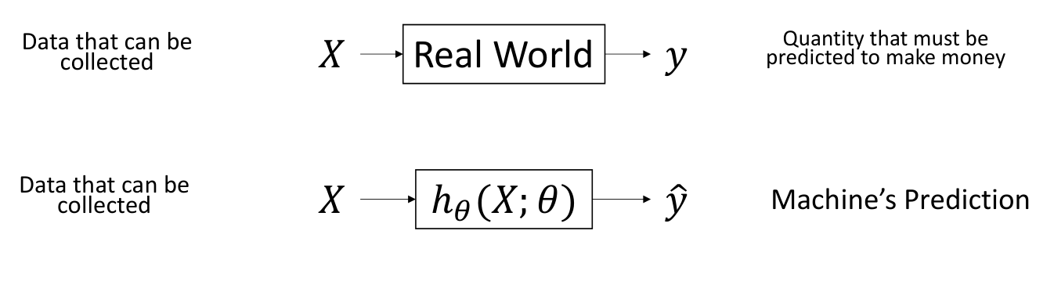
Mental Model of ML

Slide 8
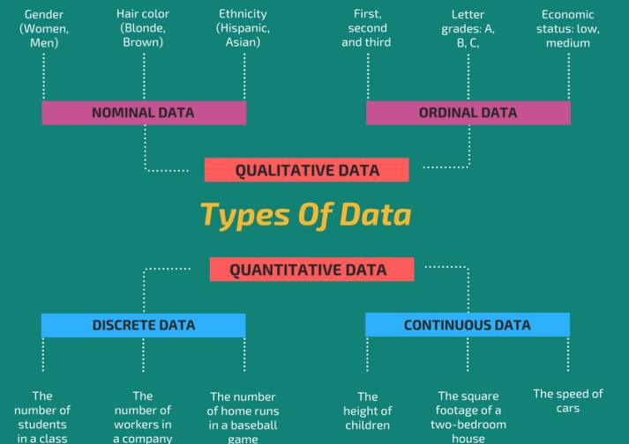
Types of Data (Top Level)

Slide 9
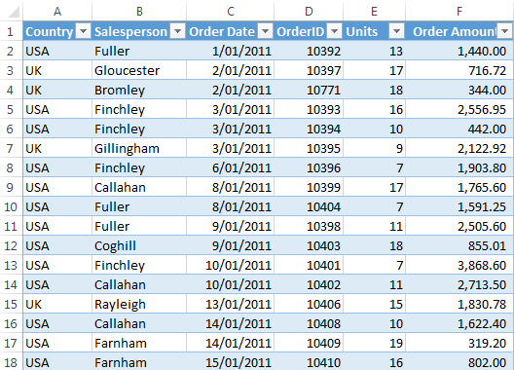
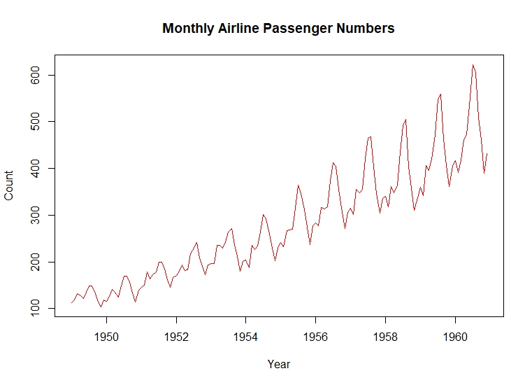
Types of Data (detailed-1)
Tabular Data
Most common form
Arises in almost all business use cases
Usually number of data points x features
Timeseries Data
Tabular but at different times (a logical ordering in time)

Slide 10
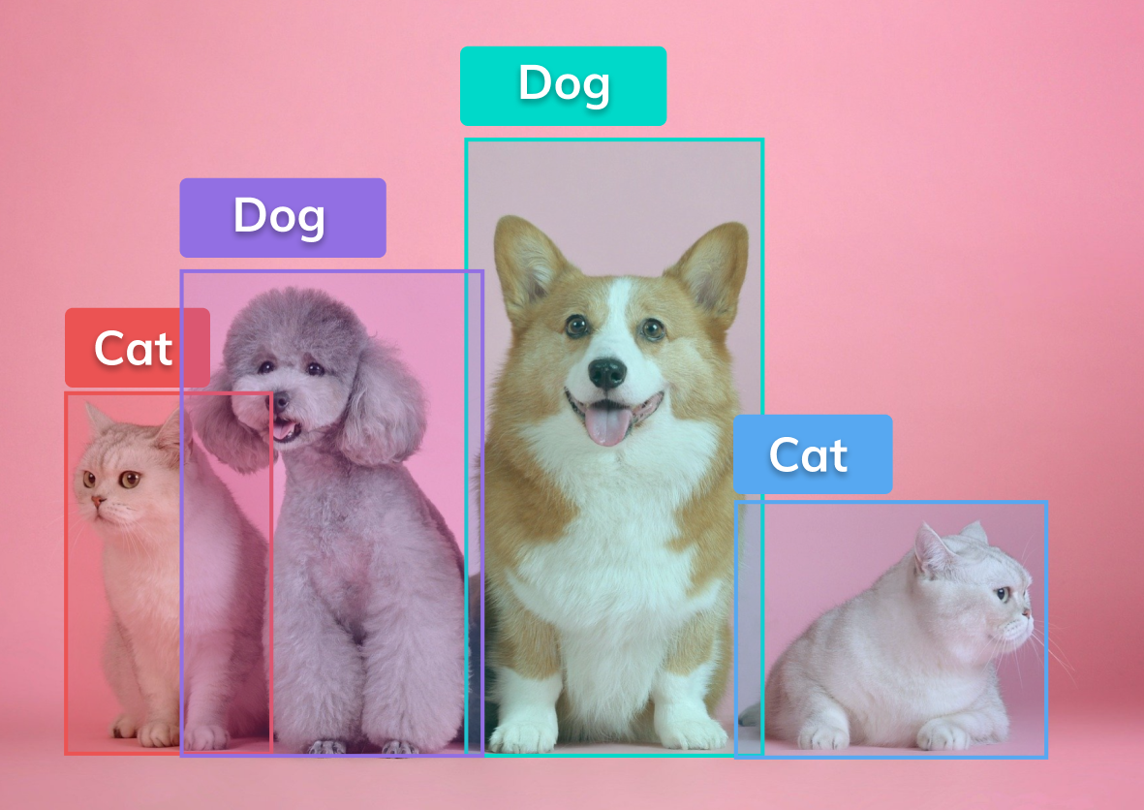

Types of Data (detailed-2)
Image Data
Increasing in recent years
Usually number of data points x height x width x sensor channels
Time series of image data is video data
Vision Tasks
Text Data
Language tasks
Usually text corpus – Needs to be converted to number – How?

Slide 11
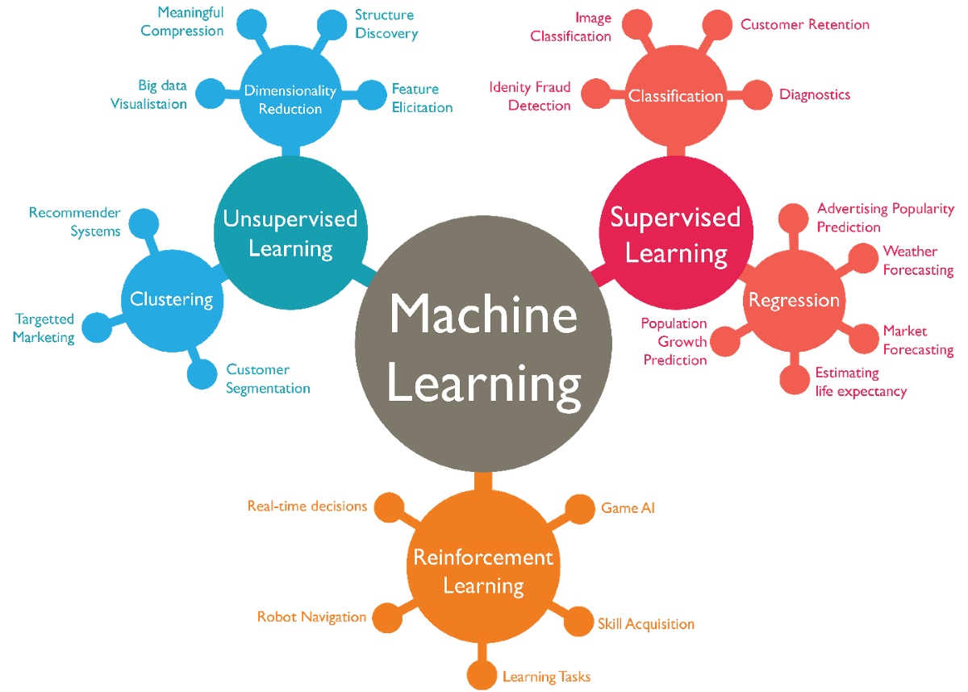
What path to choose?

Slide 12
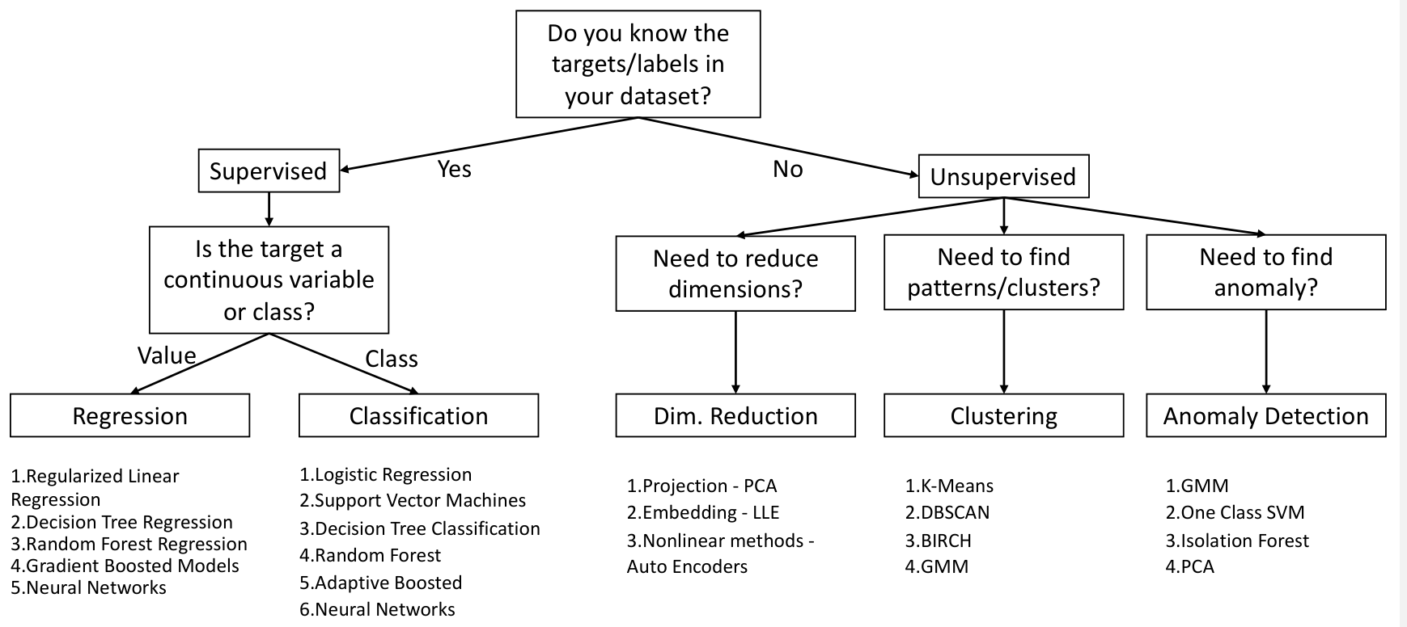
Overall Picture

Slide 13
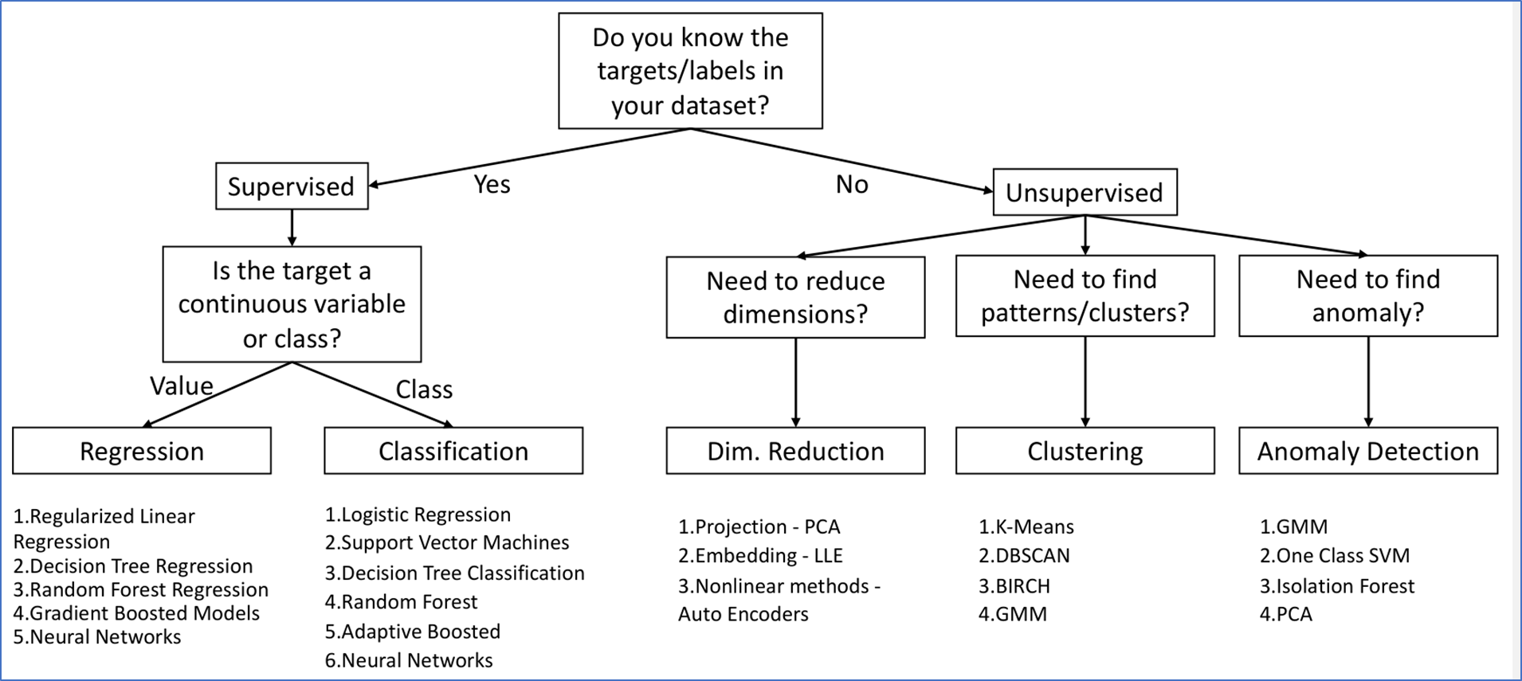
What ML method should I choose?
Predict the range of an Electric Vehicle based on data collected on correlation of battery charge and range.
Answer:
Predict the type of road (highway/potholed/offroad etc) the vehicle is currently on based on data which has a relation between vibration measurements and road type.
Answer:
Compress 20 sensor measurements captured by the car into a 2 dimensional space for predicting accident proximity
Answer:
Group vehicles into 2-wheeler/ hatchback/ /sedan/SUV/truck etc given just the wheelbase dimensions
Answer:
Figure if something is wrong with the engine based on the sound it makes.
Answer:

Slide 14
What ML method should I choose?
Predict the range of an Electric Vehicle based on data collected on correlation of battery charge and range.
Answer: Regression
Predict the type of road (highway/potholed/offroad etc) the vehicle is currently on based on data which has a relation between vibration measurements and road type.
Answer: Classification
Compress 20 sensor measurements captured by the car into a 2 dimensional space for predicting accident proximity
Answer: Dimensionality Reduction
Group vehicles into 2-wheeler/ hatchback/ /sedan/SUV/truck etc given just the wheelbase dimensions
Answer: Clustering
Figure if something is wrong with the engine based on the sound it makes.
Answer: Anomaly Detection

Slide 15
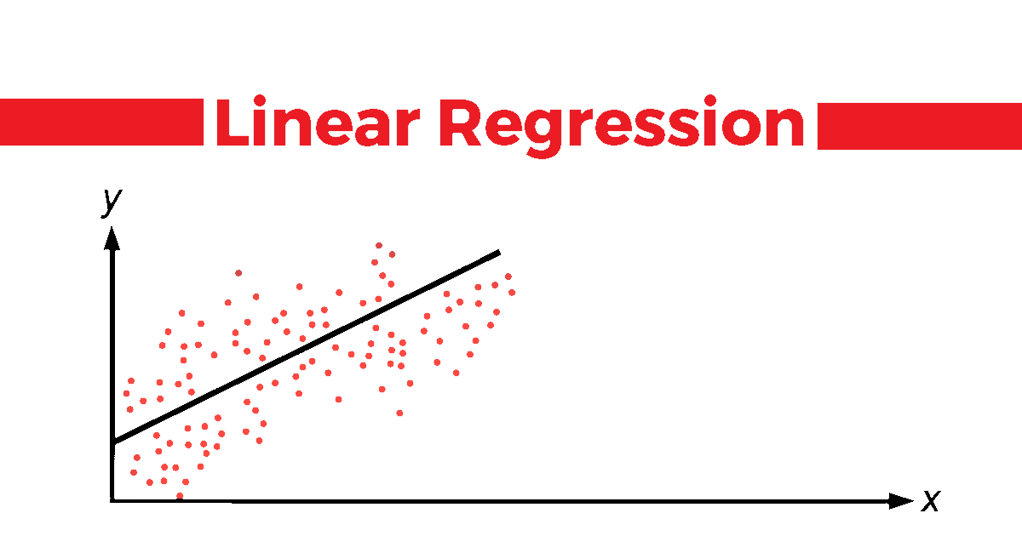

Slide 16
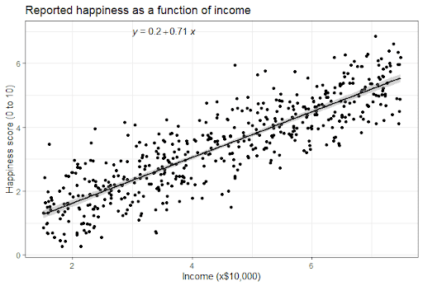
A real life example

Slide 17
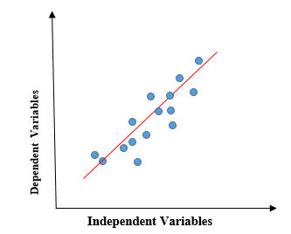
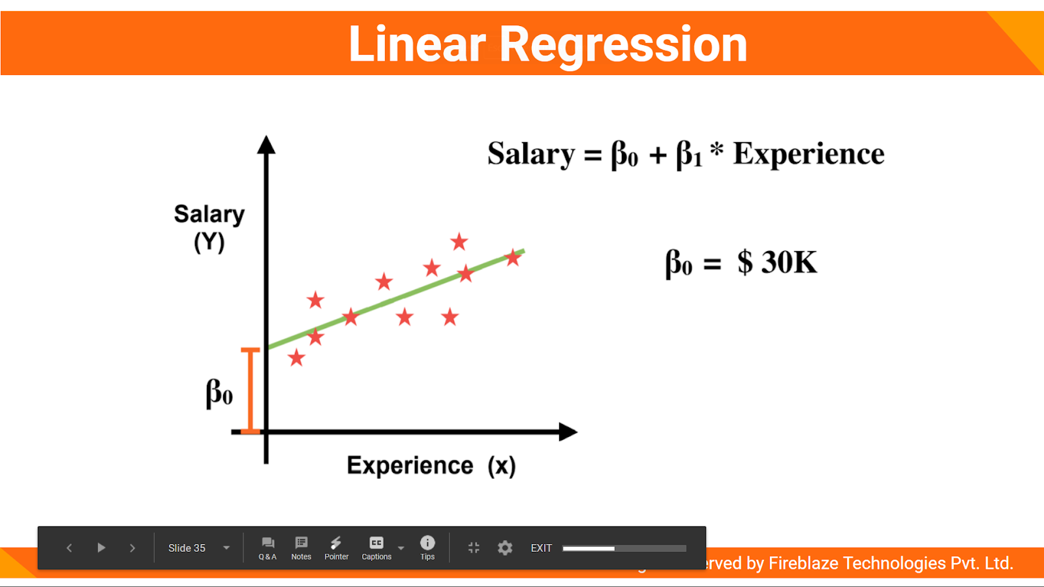
Understanding Linear Regression
Linear regression shows the linear relationship between the independent variable (X-axis) and the dependent variable (Y-axis), consequently called linear regression.
If there is a single input variable (x), such linear regression is called simple linear regression.
Predict the value of a continuous variable in a supervised setting

Slide 18
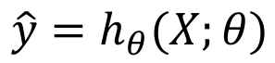
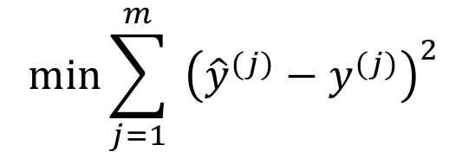
Mathematical understanding
Variable with a hat, y^ is usually the prediction from a model
ℎ is called the hypothesis, or the ML Model parametrized by 𝜃
𝜃 can be calculated, estimated or learned from data by solving the optimization problem:
Mean Square Error:

Slide 19
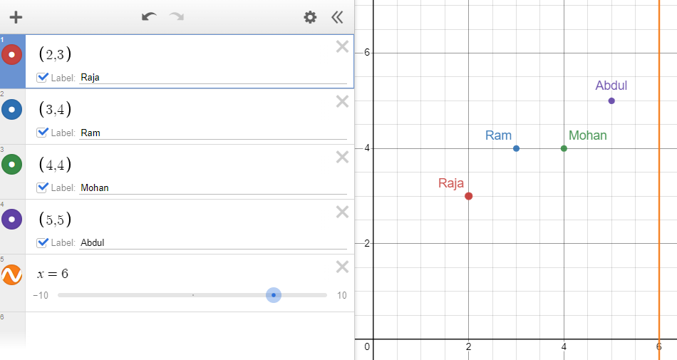
An example
Design a linear regression model to predict the value of medals won by a performer (Roy) based on years of practice
Performer | Years of practice (Independent Variable, x) | Medals won (Dependent variable, y)
Raja | 2 | 3
Ram | 3 | 4
Mohan | 4 | 4
Abdul | 5 | 5
Roy | 6 | ?

Slide 20
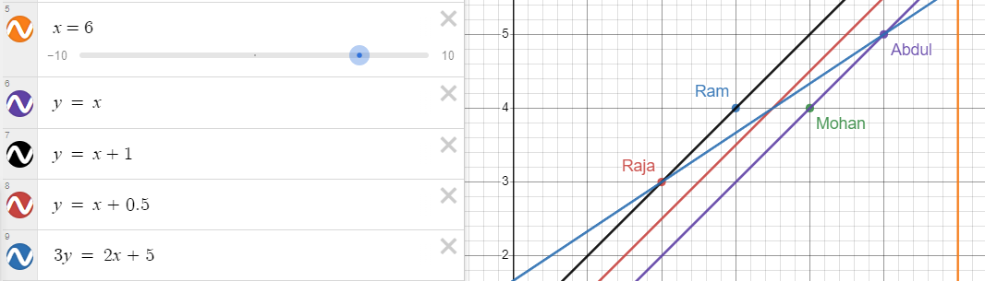
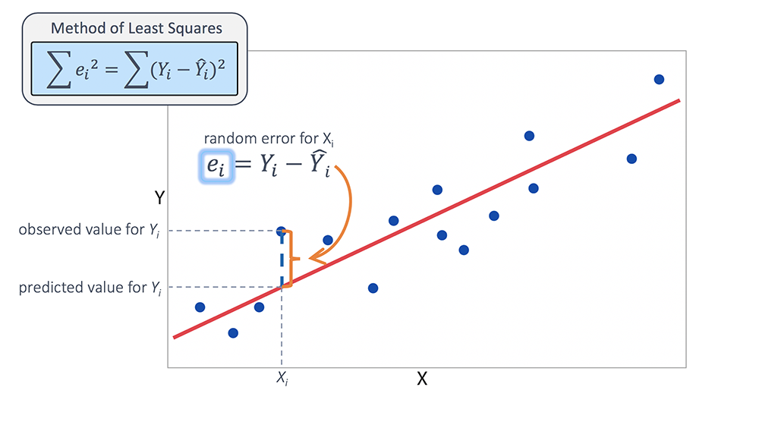
An example

Slide 21
Why can’t we just solve the optimization problem?
Solving this equation (QR- Cholesky method/ SVD) is O(mn²)
square in the number of features, and linear in the number of data points
If we increase features by a factor 2, then computational cost increases by a factor 4.
Both the Normal Equation and the SVD approach get very slow when the number of features grows large (e.g., 100,000).
As they are linear in the number of data points, they can handle large training sets efficiently, provided data can fit in memory.
We need a better optimization algorithm when train data is large.

Slide 22
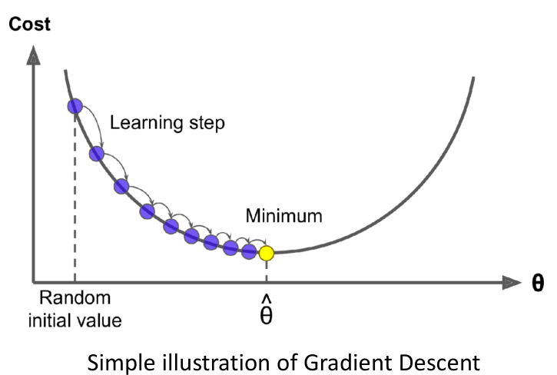
Gradient Descent
Suppose you are lost in the mountains in a dense fog, and you can only feel the slope of the ground below your feet.
A good strategy to get to the bottom of the valley quickly is to go downhill in the direction of the steepest slope.
This is exactly what Gradient Descent does: it measures the local gradient of the error function with regard to the parameter vector 𝜃, and it goes in the direction of descending gradient.
Once the gradient is zero, you have reached a minimum!

Slide 23
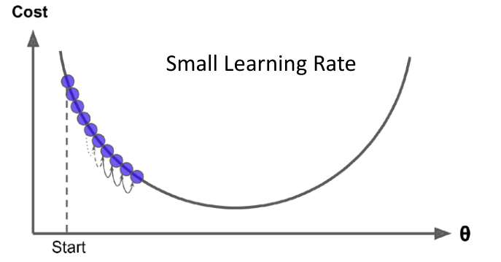
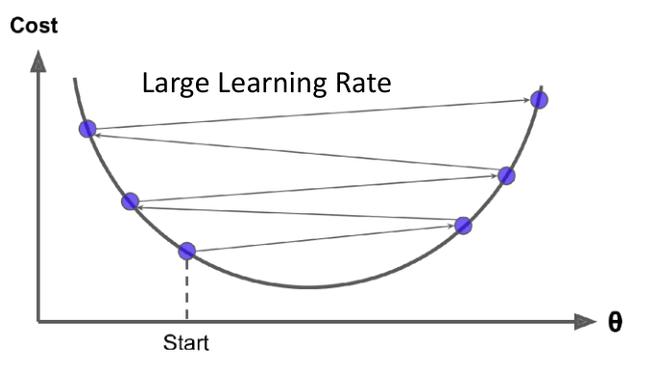
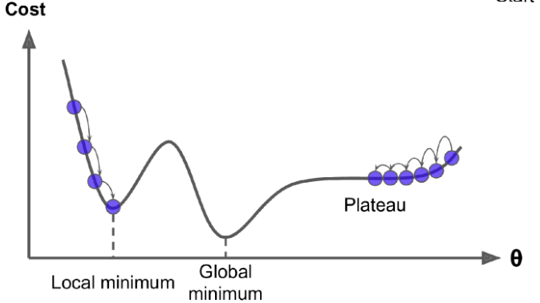
Gradient Descent
Gradient Descent may miss global minima
Very slow in a Plateau
Problem Scaling Issues
To ensure fast convergence, use scaled features

Slide 24
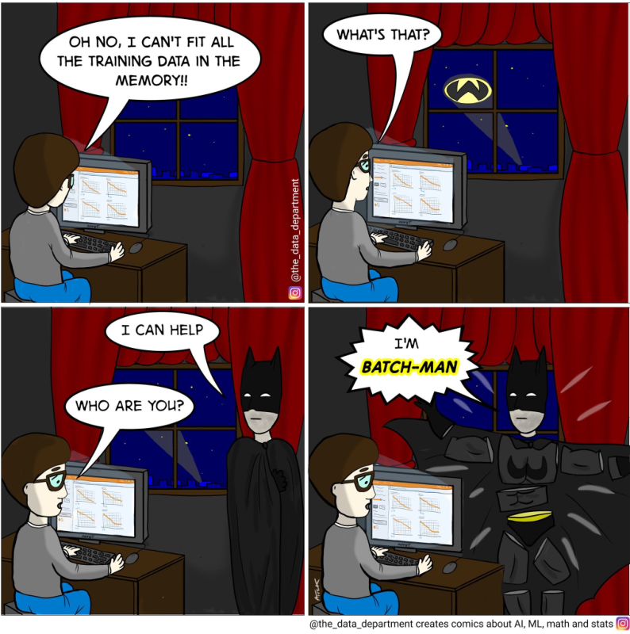
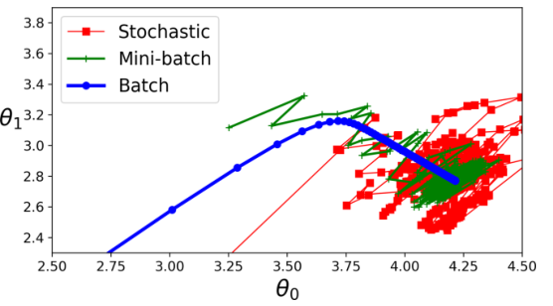
How do I solve this Gradient Descent problem!
Woohoo! Linear regression solved!

Slide 25
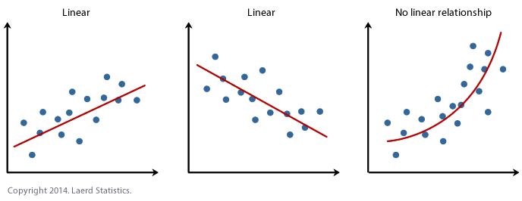
Sneak peek into Polynomial regression
The key property of our Linear Model so far is that the loss function that is minimized (the obj. function) is linear in the parameter 𝜃 (the decision variable) – i.e not ‘x’
The same ideas that we have discussed so far can be used even when the input-output relationship is nonlinear.

Slide 26
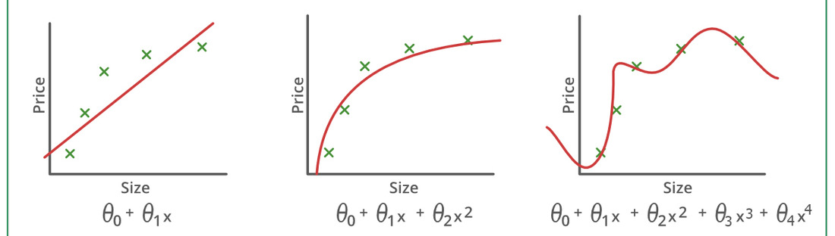
How well am I fitting the curve?
It is up to us to decide the number of features (‘x’) to use to fit the data.
Using a low degree (may) lead to underfitting.
Low computational cost, high error
Using a high degree (may) lead to overfitting.
High computational cost, low error

Slide 27
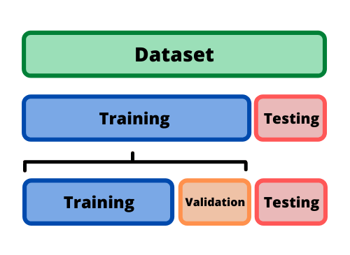
Splitting the dataset
To test our model’s performance, we separate out a ‘Test Set’ which is never seen by the model until evaluation.
The training data, however can be split for validation to better the model’s performance.

Slide 28
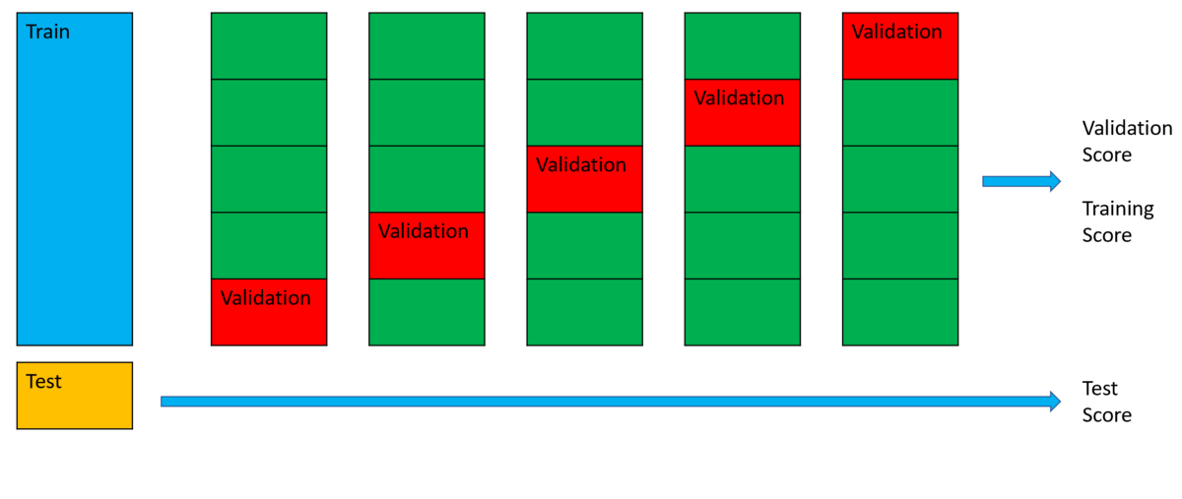
How to know if you are overfitting or underfitting?
Answer 1: Cross-Validation
If a model performs well on the training data but generalizes poorly according to the cross-validation metrics, then your model is overfitting.
If it performs poorly on both, then it is underfitting.

Slide 29
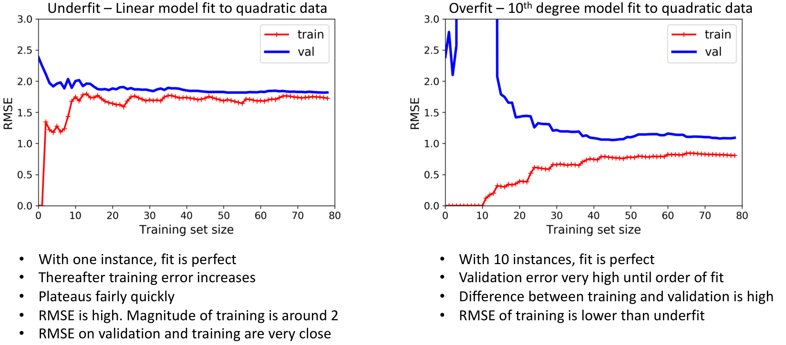
How to know if you are overfitting or underfitting?
Answer 2: Learning Curves
Plots of the model’s performance on the training set and the validation set as a function of the training set size (or the training iteration)

Slide 30
Bias and Variance
A model’s generalization error can be expressed as the sum of three very different errors:
Bias: due to wrong assumptions, such as assuming that the data is linear when it is quadratic.
A high-bias model likely underfits the training data.
Note: This bias is not the bias-term/intercept.
Variance: excessive sensitivity to small variations in the training data.
A model with many degrees of freedom (such as a high-degree polynomial model) is likely to have high variance and thus overfit the training data.
Irreducible Error: Due to inherent noise in the data
Error = Bias² + Variance + Irreducible Error

Slide 31
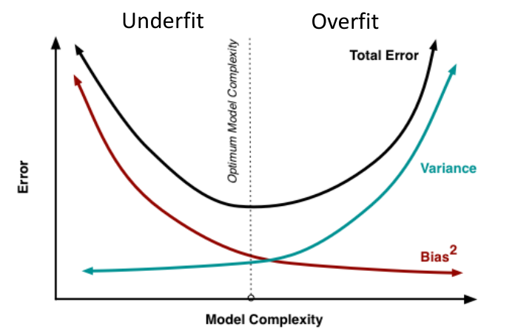
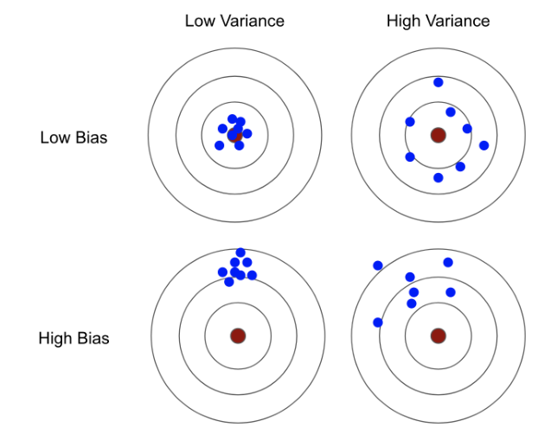
Bias-Variance tradeoff
Increasing a model’s complexity will increase its variance and reduce its bias.
Reducing a model’s complexity will reduce its variance and increase its bias
Bias: Error from erroneous assumptions in the model
High bias -> underfitting
Model has limited flexibility to learn
Analogy: Overly simplistic assumptions about people make you a biased person
Variance: Error from sensitivity of model to small perturbations in training data
High variance -> overfitting
Model has too much flexibility to learn
If you have a lot of data and over complex model, you can make each parameter of the model “by-heart” one data point
When a new data point comes, then the model will change wildly to accommodate the new point

Slide 32
Self Learning
Regularization:
Ridge, Lasso, Elastic Net
Generally avoid plain Linear Regression - almost always preferable to have some regularization
Ridge is a good default, but if we believe that only a few features are useful (from domain expertise), then prefer Lasso or Elastic
Between lasso and elastic, prefer elastic as lasso may behave erratically when 𝑛 > 𝑚

Slide 33
Logistic Regression
This is a misnomer!
Logistic Regression is a Classification Algorithm

Slide 34
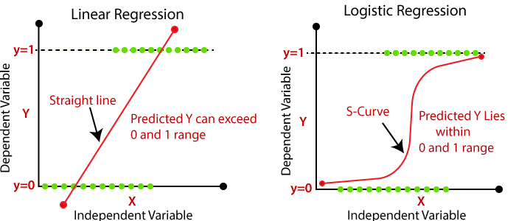
Linear regression v/s Logistic Regression

Slide 35

Logistic Regression
When the task is binary classification, we can set the target to the probability that a particular label is obtained
To make regression a binary classification task:
Predict a probability
If the estimated probability > 50%, predict that the instance is in the positive class, labeled “1”,
and otherwise predict that it belongs to the negative class, labeled “0”.
How to predict the probability?
Use a sigmoid function

Slide 36
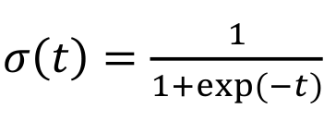
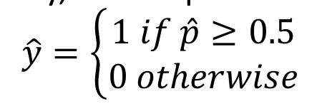
Equation behind Logistic Regression
Logistic or Sigmoid Function
Takes an input in (−∞, ∞) and returns a value between 0 and 1
‘t’ is like regular regression (t = y^ = mx^ + c)
After estimating probability, class is predicted as:
The sigmoid function is such that 𝜎 (𝑡) ≥ 0.5 when 𝑡 is positive
• When y^≥ 0, the class label is 1, else 0

Slide 37
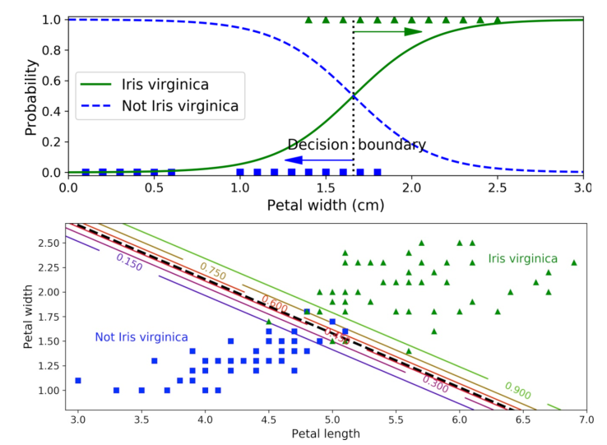
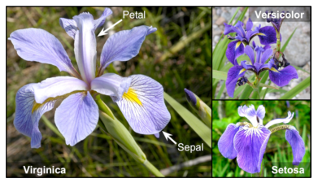
Example of Logistic Regression

Slide 38
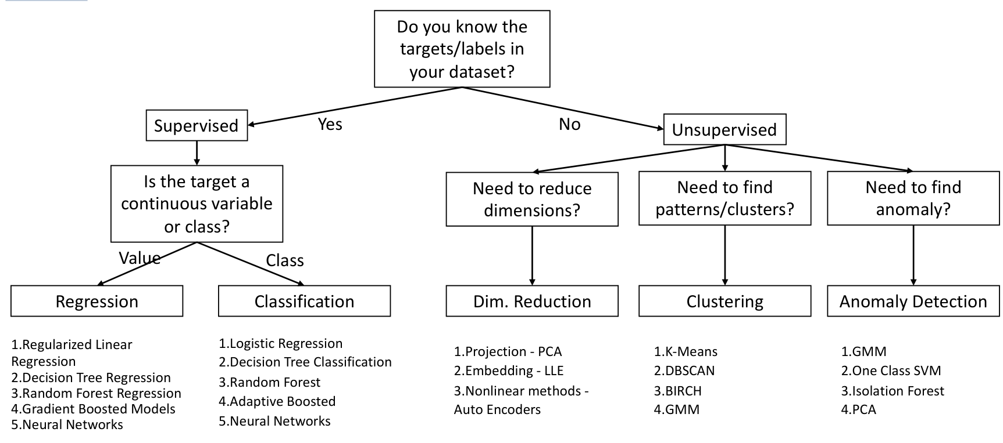
Summary
Completed
This week
Next Week
Last class

Slide 39
Decision Trees

Slide 40
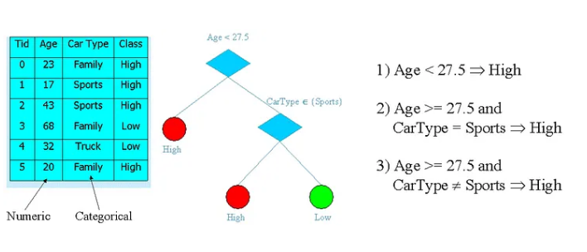
About Decision Trees
Decision trees are used for both classification and regression problems, this story we talk about classification.
Decision tress often mimic the human level thinking so its so simple to understand the data and make some good interpretations.
Decision trees actually make you see the logic for the data to interpret
A decision tree is a tree where each node represents a feature(attribute), each link(branch) represents a decision(rule) and each leaf represents an outcome(categorical or continues value).

Slide 41
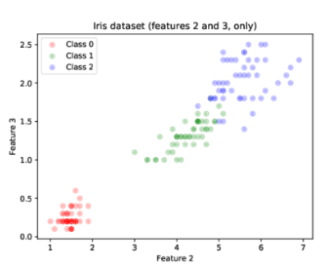
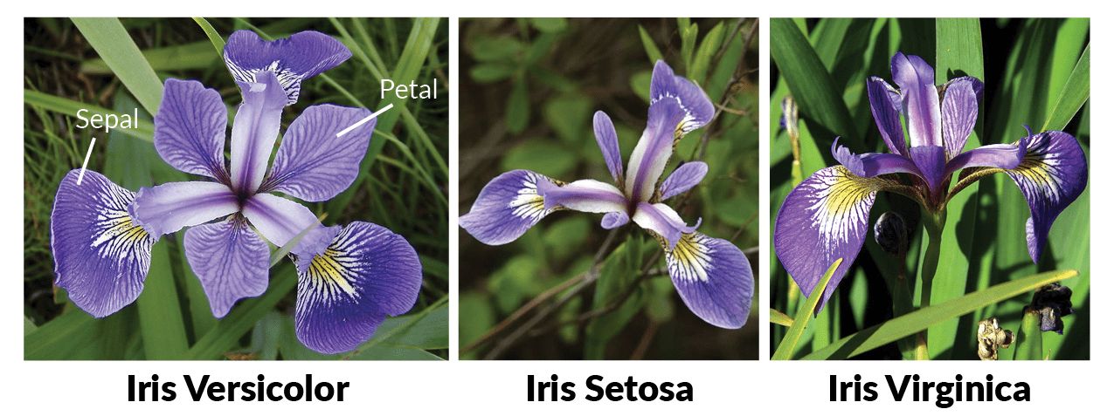
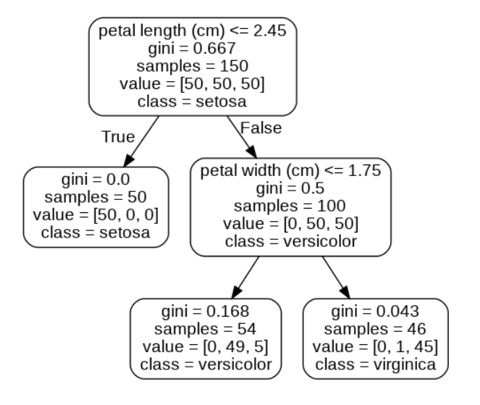
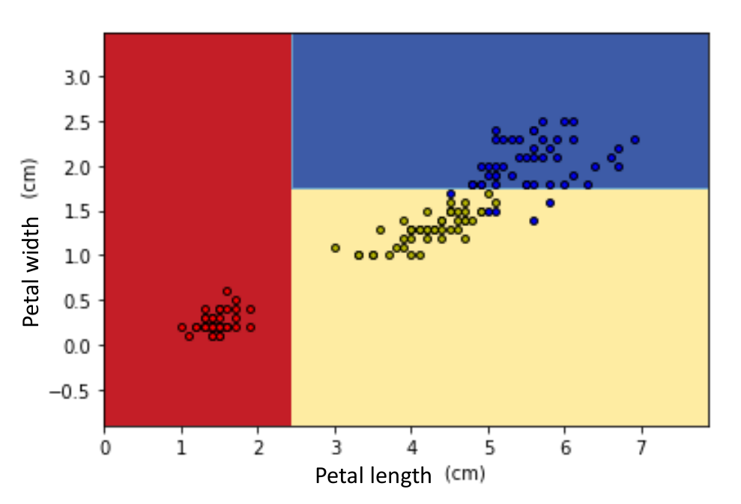
Decision Boundaries

Slide 42
Interpreting the model
DT gives a prediction that is easy to interpret
The rules can even be applied manually and understood
These kind of models are called as “white box models”
Neural Network or Random Forests are called as “black box models”
In NN or RF, it is difficult to explain why a particular instance was classified in a particular class.
Advantage of DT: DT doesn’t need any scaling of data
Note: Sklearn uses CART algorithm, which produces only binary trees
Binary tree – only two children per node
Other algorithms such as ID3 can produce more than two children per node

Slide 43
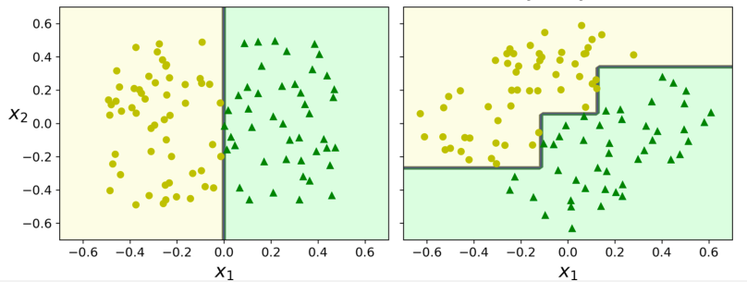
Issues with Decision Trees
Decision Trees are very sensitive to small variations in the training data
Removing an outlier data point may drastically change the DT
Scikit-Learn randomly selects which feature to evaluate first at each node
May get different Decision Trees on different runs on same data!
Set random_state hyperparameter to control this behavior
Random forests can overcome this instability by ensemble learning!

Slide 44
Ensemble Learning

Slide 45
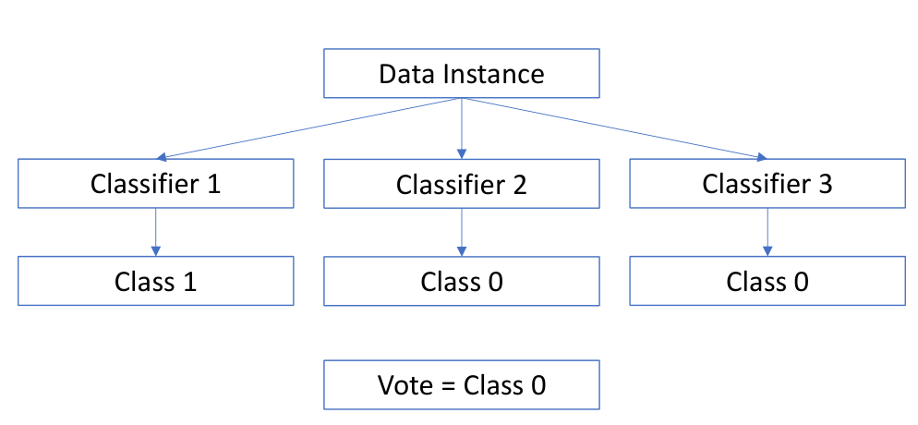
What is this?
Audience poll/Wisdom of the crowd: Pose a complex question to 1000s of random knowledgeable people and aggregate their responses
The average response is usually better than one experts response, even if the random people are only knowledgeable
This idea is called Ensemble Learning
Example:
Train different Decision Trees on random subsets of the training data
Make the final prediction as an average of all the trees
Multiple trees trained on random subsets -> Random Forests!
Different ensemble techniques: Voting, Bagging, Boosting, Stacking

Slide 46
Voting Classifier
Theory: If each classifier is a “weak learner” (just slightly better than random guess), and there is a diverse set of weak learners, the ensemble can be a “strong learner” (high accuracy)
Let us say each has about 80% accuracy
Now let us gather a vote from all these classifiers and assign our final prediction as the majority vote
This “voting classifier” is usually better than the best among the ensemble
Let us toss a biased coin with p(H) = 51% (slightly above unbiased)
If we toss it once, then we can get H or T almost equally
Let us toss is 100 times, then ideally it should be 51 vs 49, still close
What if we toss it 1000 times, 10,000 times? We get 510 vs 490, 5100 vs 4900, in both cases, with an observable difference
Ensemble works in a similar way
If several classifiers have an accuracy slightly better than random guessing
The majority vote of the ensemble with sufficient ensemble members approaches 75% accuracy or better

Slide 47
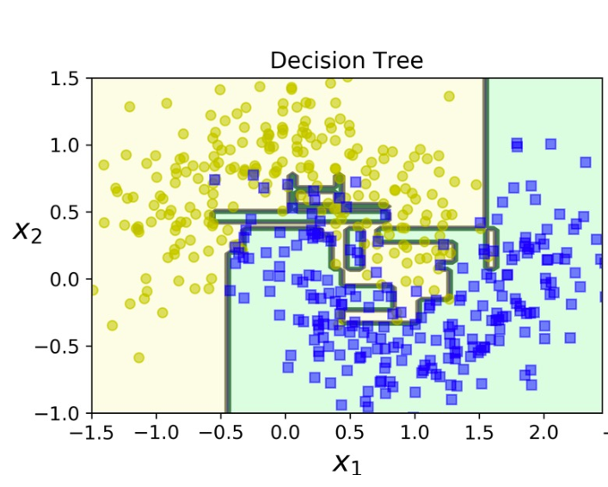
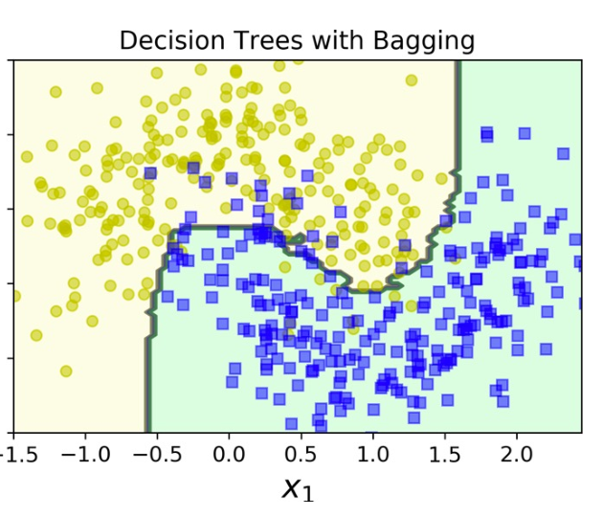
Bagging
To get an ensemble using the same classifier, we can train them on multiple random subsets of the training data
After all predictors have been trained, a new instance can be classified by aggregating the results from the ensemble members
Aggregation can be a hard voting classifier, or average for regression
Each individual predictor has a higher bias, but aggregating reduces both bias and variance
Ensemble learning scales well for computation – it can be easily parallelized

Slide 48
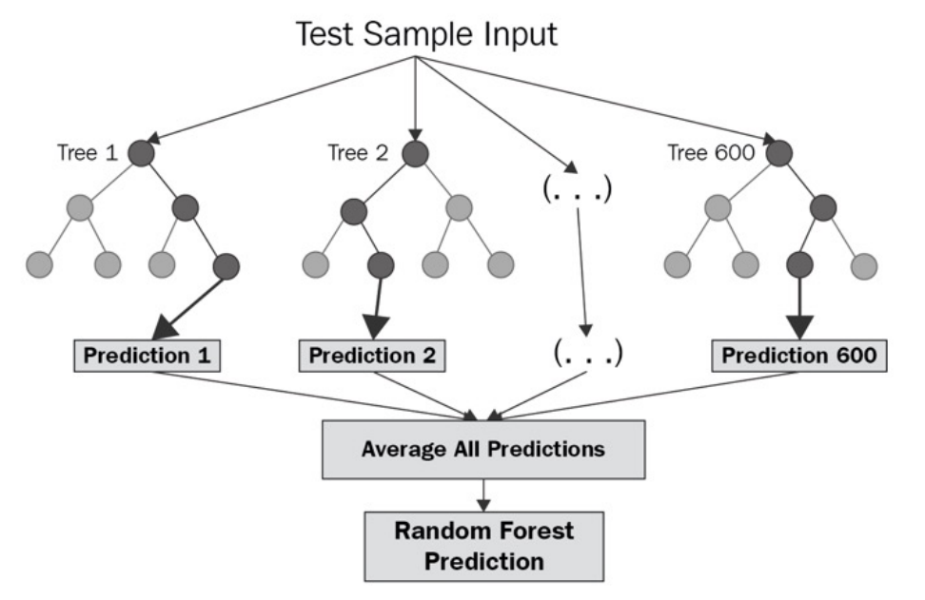
Random Forests
Random Forest - Ensemble of Decision Trees trained via Bagging
Almost any machine learning problem can be solved satisfactorily with this method!

Slide 49
Boosting
Boosting is a Sequential Ensemble method
General Idea – Train predictors sequentially so that each successive predictor corrects the errors of its predecessor
Imagine a sequential learning system
The first learner uses all the data for training. There may be some wrong predictions
The second learner tries to learn from all the wrong predictions. There may still be some more wrong predictions
Repeat
Among several Boosting Methods available, the most popular are
Adaptive Boosting (AdaBoost)
Gradient Boosting (e.g., XGBoost)

Slide 50
XGBoost, Adaboost
Adaboost: In Adaptive Boosting, each sample weights are updated sequentially based on the wrong predictions.
More suited for classification tasks
XGBoost: In Gradient Boosting, subsequent predictors are trained on the residual errors made by the previous predictor.
This setting is more natural for regression
Classification is done as a regression using deviance (or exponential) loss function as the error to which subsequent predictors are fit

Slide 51
Summary
Completed
Next Week
Last class

Slide 52
Deep Learning

Slide 53
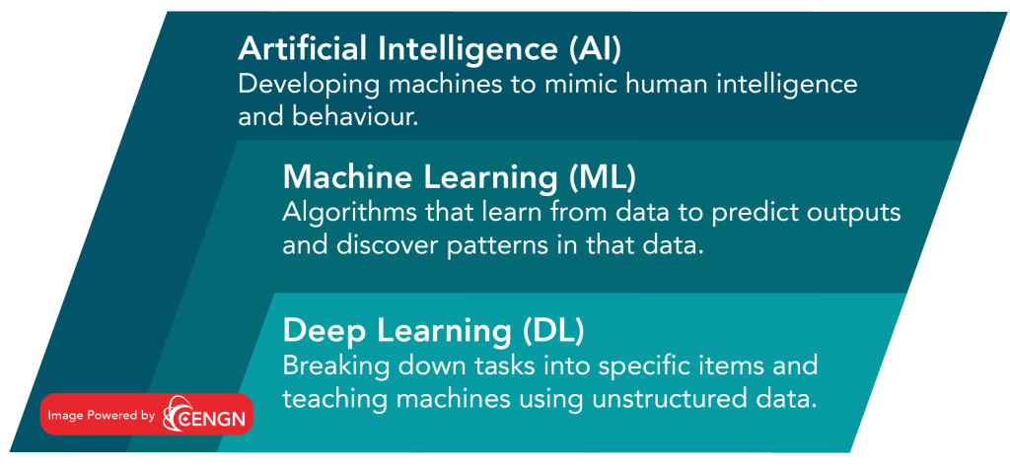
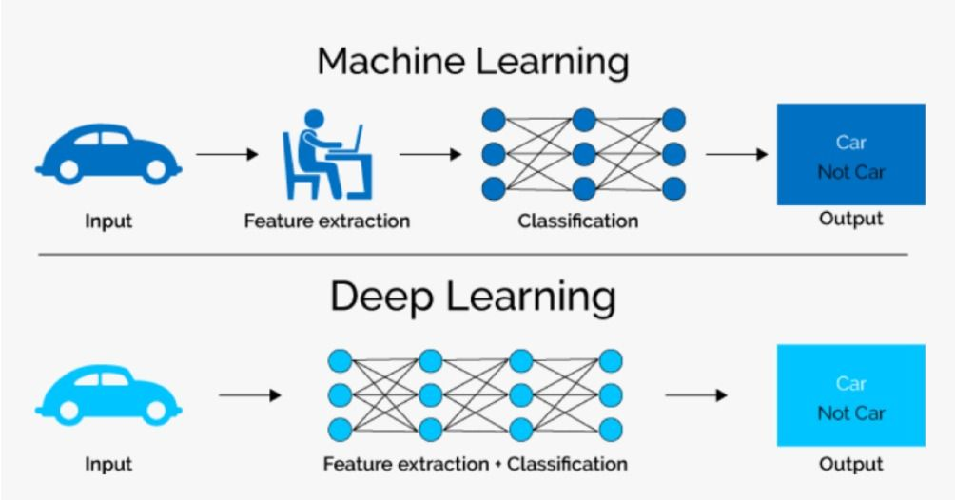
Machine Learning v/s Deep Learning
Machine Learning (ML):
Algorithms that learn from structured data to predict outputs and discover patterns in that data.
Deep Learning (DL):
Algorithms based on highly complex neural networks that mimic the way a human brain works to detect patterns in large unstructured data sets.

Slide 54

Where is Deep Learning Used?

Slide 55


Intuition on Deep Learning

Slide 56


The backpropagation training algorithm
1. Epoch: One pass handles a mini-batch at a time
(for example, containing 32 instances each).
It goes through the full training set multiple times.
2. Forward pass: makes a prediction and measures the error
3. Backward pass: goes through each layer in reverse to measure the error contribution from each connection
Gradient Descent step: tweaks the connection weights to reduce the error

Slide 57


How backpropagation works?

Slide 58
Deep Learning Libraries
 | Keras | PyTorch | TensorFlow
API Level | High | Low | High and Low
Architecture | Simple, concise, readable | Complex, less readable | Not easy to use
Datasets | Smaller datasets | Large datasets, high performance | Large datasets, high performance
Debugging | Simple network, so debugging is not often needed | Good debugging capabilities | Difficult to conduct debugging
Does It Have Trained Models? | Yes | Yes | Yes
Popularity | Most popular | Third most popular | Second most popular
Speed | Slow, low performance | Fast, high-performance | Fast, high-performance
Written In | Python | Lua | C++, CUDA, Python

Slide 59


Slide 60
Summary
Completed
Finally!

Slide 61
Common Unsupervised Learning Tasks
Clustering
Group similar instances to clusters
Issue: No labels on clusters!
Anomaly Detection
Learn what “normal” data looks like, and use that information to identify anomalies
Issue: No labels of what is normal!

Slide 62

K Means Clustering
Clustering
The task of identifying “similar” looking items, and form clusters/groups
We don’t need to know the name of the cluster
We simply group together similar items
We have to find k centroids that act as leaders/representatives of the k groups
We must assign datapoints to one of the k group that it is closest to
Once data point have been assigned to a cluster, recalculate its centroid
Reevaluate if the clustering has changed based on the new centroid
Continue until centroid stops moving
Visualization

Slide 63


Auto Encoders (for Anomaly Detection)

Slide 64




Generative Adversarial Networks

